Slide 1

One Water
One Watershed:
A New Model for Resources Management
Santa Ana Watershed Project Authority
Jeffrey Beehler, Ph.D.
Environmental Program Manager

Slide 2
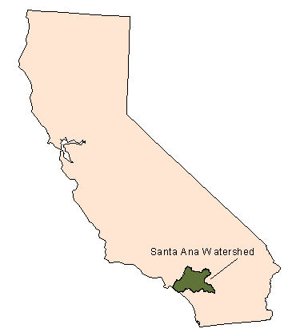
Setting
Santa Ana River Watershed
  Largest coastal stream system in Southern California
  Covers over 2650 square miles in parts of four counties
  Quickly urbanizing home to over 5 million people
  Population projected to increase to 7 million by 2020

Slide 3
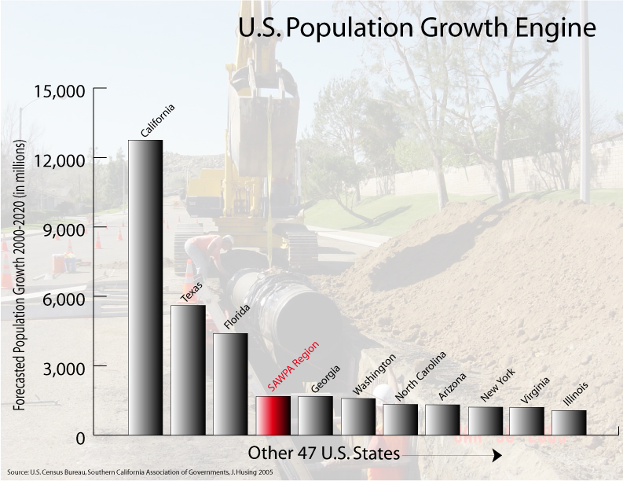

Slide 4
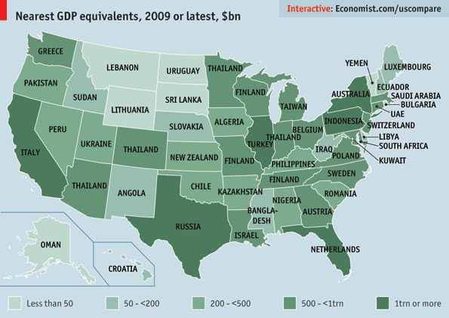
Keeping Things in Perspective

Slide 5
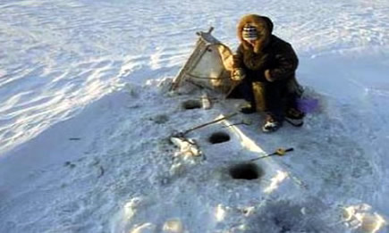
What Does This Slide Have to do with Water?
Sometimes we look at the world too narrowly
Inuit “urban legends”

Slide 6

What Kind of Water?
Paper Water
Storm Water
Surface water
Groundwater
Wastewater
Recycled water
Environmental water
Nuisance water
Notes:
Increasing demands on limited water resources requires a new planning approach
Collaborative regional process results in better (integrated, multi-function) solutions
Communication among multiple stakeholders engenders greater buy-in
More funding is being made available based on the regional integration model that was pioneered by SAWPA

Slide 7
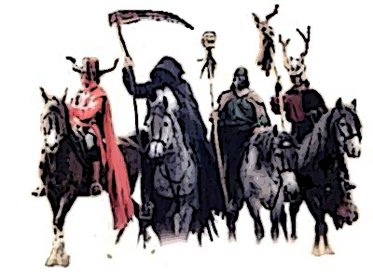
Four Horsemen of the Apocalypse
Reduced Water from Delta
Climate Change
Colorado River Basin Drought
Explosive Development & Population growth
Notes:
Climate Change will bring us reduced rain and snow. There will be less snowpack in the Sierras which has been our natural freezer where Mother Nature keeps it until we need it in the summer. Rain will come in flash floods.
Reduced water from the Delta: With up to 33% reduction in pumping we will have significantly less water to bring down from the North, the amount of water that would serve the Cities of Riverside and Corona
Population growth & Development: More people=more demand and more concrete & asphalt means interrupted hydrology less replenishment of our groundwater aquifers. Population forecasts indicate that the watershed will see the addition of 1.4 million people reaching 7.3 million by 2025.
Now we can plan for population growth and people themselves do not consume much water.
It is not that we grow but rather how we grow that concerns us. Are we going to pave over paradise and Interrupt hydrology and groundwater recharge while increasing water needs
Increased development will reduce groundwater recharge opportunities which will further deplete Santa Ana groundwater supplies currently accounting for 60% of the watershed’s water supply
Colo river drought, last 8 yrs the driest in recorded history. That is 122,000 acre feet /yr enough for Corona

Slide 8
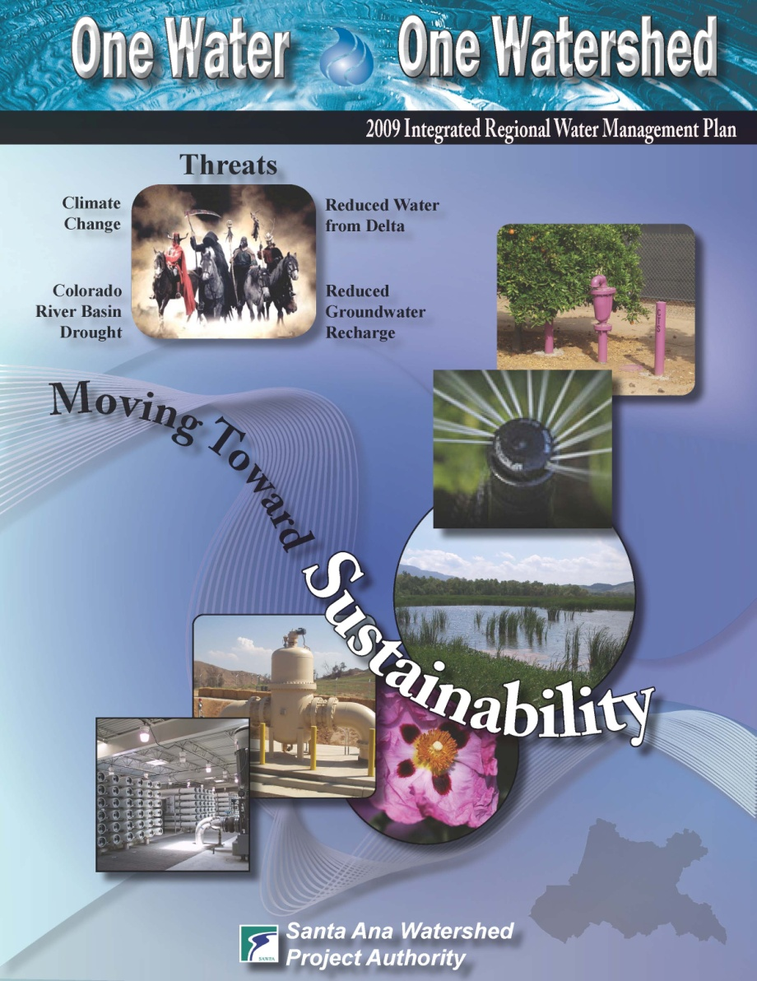
One Water One Watershed OWOW Plan
Integrated Regional
Water Management
Planning for Santa Ana River Watershed
Over 2000 watershed stakeholders involved
Template for future statewide water resource planning

Slide 9
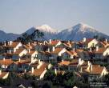







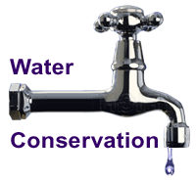

Pillars: Integrate Complexity
Land Use
Climate Change
Flood Control and
Stormwater Runoff
Water Quality
Improvement
Environment
& Habitat
Water
Supply
Reliability
Water
Recycling
Parks, Recreation & Open Space

Slide 10
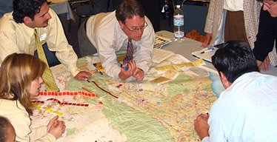
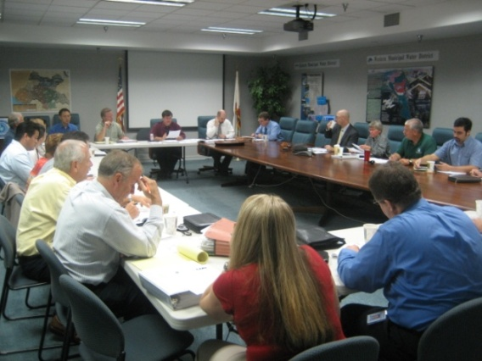
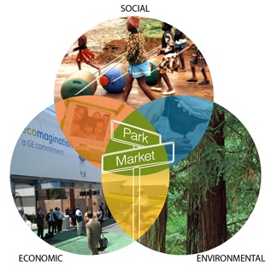
OWOW Guiding Principles for Municipal and Civil Leaders
Create Anew – OWOW
2
Collaboration Across Boundaries – Citizens of watershed,
3
Adopt Systems Approach –Problems are interrelated, seek synergies, create catalysts
1
shared vision and adopting a
new water ethic
multi-jurisdictional solutions
Notes:
Managing the water resources at the watershed scale, while difficult, offers the potential of balancing the many competing demands we place on water resources. The watershed approach acknowledges linkages between uplands and downstream area, and between surface and ground water and reduces the chances that attempts to solve problems in one realm will cause problems in others. Watershed management integrates all the various human activities that occur on a given area of land that have effects on or affected by water. We focus on all sources by pollution with in the watershed as a whole rather than on types of sources or on the arbitrary political boundaries of counties and municipalities. With this perspective we can plan long term sustainable solutions to many natural resources problems. We can find a better balance between meeting today’s needs and leaving a sound resource legacy for generation to come.

Slide 11
Components of Ideal Project
Ideal
OWOW
Project
Watershed
Approach
Multi
Jurisdictional
Multiple
Benefits
Env. Justice/
DAC
Sustainable
Ready to
Implement
Adaptability
to Climate
Change
Notes:
We asked the stakeholders to move easily from problem solving to creating, to create a new shared vision and to realize breakthrough innovations. To be both pragmatic and visionary, to look at possibility, evoking inspiration and creativity throughout the watershed. The change we are seeking is not a call to try harder to maintain the status quo. If we always do what we’ve always done we will always get what we got.
Problem solving is about making what you don’t want go away. Creating a new involves bringing something you care about into reality such as sustainability, water reliability and quality. We are shifting the conversation from the familiar avoiding something bad to doing something positive and new. Shifting the conversation from problems to possibilities.
We asked people who feel strongly to let go of cherished beliefs and views so that they can allow something bigger than themselves to develop.
It all comes down to choice and the capacity to focus on a vision of what we truly desire instead of what we seek to avoid.
Build a Prius not repair the edsel
Establish a new Water Ethic

Slide 12
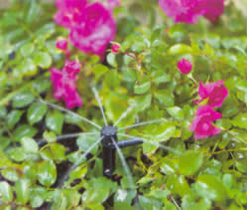
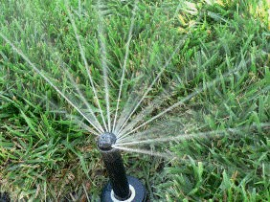
Biggest Bang for Buck:
Water Use Efficiency

Slide 13
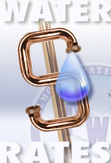
Value Water Differently
  Develop a “Water Ethic”
  Price water using Allocated Tiered Rates to set price points and to reflect true costs.
  Value of water to region exceeds its dollar cost
Notes:
Our residents need to know where their water comes from, and at what cost. Also where it goes after they use it. They need to understand its volume. Develop a sense of how much they use personally and in the yard.
And in the end we learned to value ourselves differently. We had an identify crisis as radical as a gender change. The water supplier became Water Resource managers, and the waster water treatment engineers become drinking water source protectors, The Flood control guys turned into drinking water managers and we all understand each others challenges better and therefore could manage our own responsibilities in such as way as to not create problems for each others but also so that downstream problems could be solves. This is the new Paradigm.

Slide 14
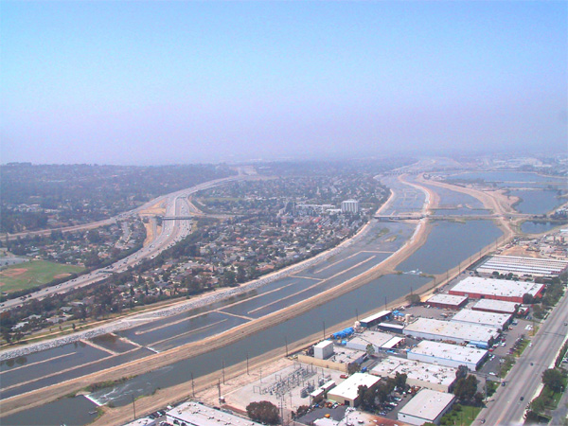
Manage Rainfall as a Resource
Provide appropriate flood control capacity and other benefits to the community
Maximize beneficial use of rain water
Notes:
Better connect flood control system to ground water system
Alluvial fan recharge to improve groundwater quality
Re-purpose retention and detention basins
Recharge within system requires revised management strategies
MS-4 Permit compliance may encourage increased stormwater capture
Between 1970 and 2000, the total average volume rose from less than 50,000 to over 146,000 acre feet per years as measured at Prado Dam.
Storm Events
Some highly populated areas are vulnerable to flooding even in modest storms due to planning & development inefficiency.
Dry Weather Runoff
Runoff causes water quality problems to receiving waters
Water Conservation
Rainwater capture
Ecological Impacts

Slide 15
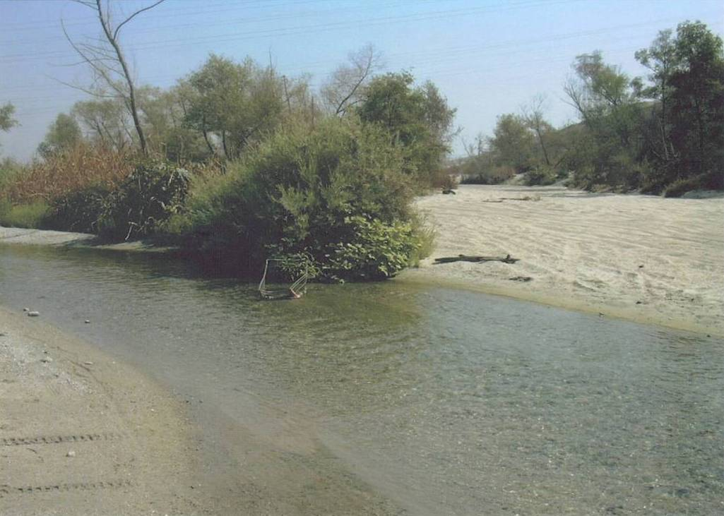
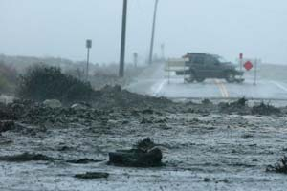
Management in a Flashy World

Slide 16
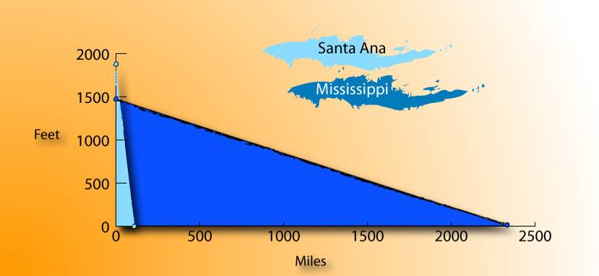
Santa Ana vs. Mississippi
The Santa Ana River goes from 1,880 feet in elevation down to sea level in only 96 miles.
The Mississippi River goes from 1,475 feet in elevation down to sea level in 2,320 miles.

Slide 17
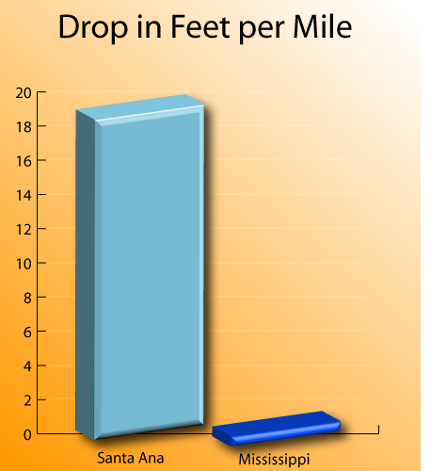
Santa Ana vs. Mississippi
The Santa Ana River drops 19.5 feet in elevation per mile.
By comparison, the Mississippi River only drops 0.6 feet in elevation per mile.

Slide 18
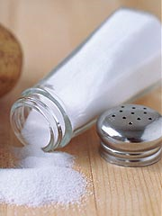
Develop Local Water Resources
Groundwater resources are key to our success in the Santa Ana Region
  Increase natural recharge
  Make use of imported water when available
Must manage basin quality
  Salt
  Nitrogen

Slide 19
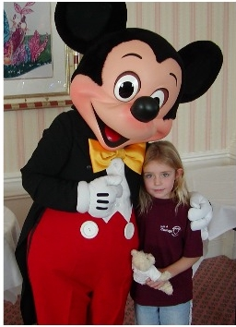
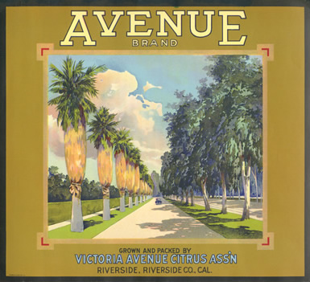
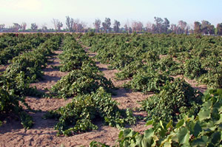
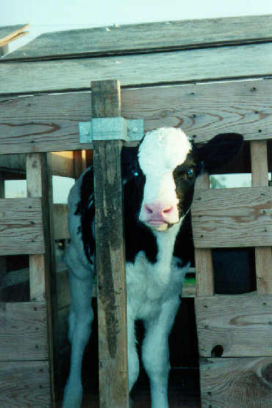
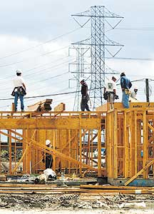
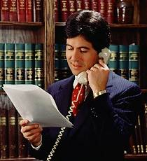
Economic Engine Changing
From:
To:

Slide 20
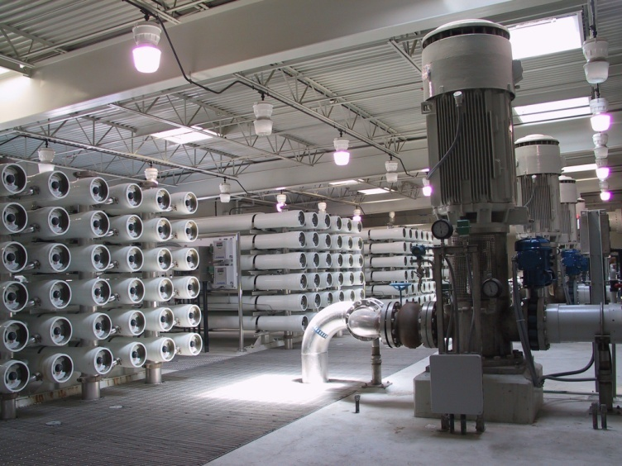
Desalting Groundwater
SAWPA constructed first two
groundwater desalting facilities in upper
Santa Ana Watershed
Arlington Desalter
Chino I Desalter
SAWPA helped fund the following
desalting facilities:
EMWD Menifee Desalter
EMWD Perris I Desalter
OCWD Groundwater Replenishment System
IEUA Chino II Desalter

Slide 21
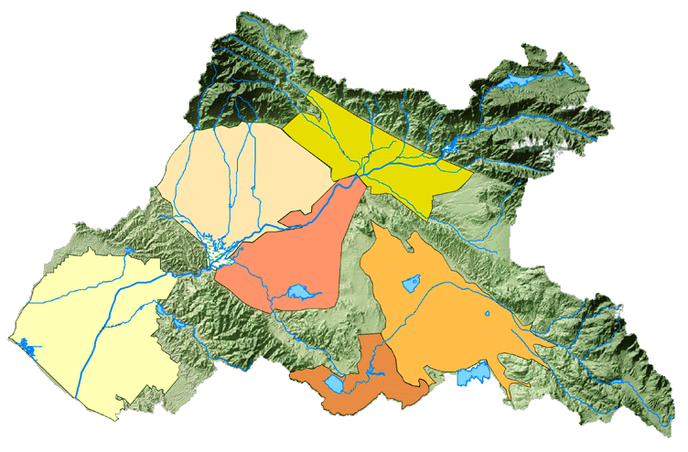
Watershed Salt Accumulation
37,000 dump trucks lined up
end-to-end from Los Angeles
to Las Vegas (every year)
1.2 Million Tons/Yr
Bunker Hill
Chino
0.6 Million Tons/Yr
Riverside/Corona
Orange
County
0.6 Million
Tons/Yr
Perris/Hemet
Elsinore
Ocean
Santa Ana River Watershed and Groundwater Basins

Slide 22
Inland Empire Brine Line
Los Angeles
County
San Bernardino
County
IEUA
IEBL
Ontario
San Bernardino
SBVMWD
Chino
Riverside
Santa Ana River
Watershed
Boundary
Riverside
County
OCSD Plant No. 1
Corona
OCWD
WMWD
EMWD
Huntington
Beach
Orange
County
OCSD Plant No. 2
Temecula

Slide 23
IEBL Description
Length - 93 miles
Pipeline size: 16 - 84 inch
Pipeline Capacity: 30 - 36 mgd
24 Direct Connections
  15 Industrial
  4 Desalters
  5 Domestic Waste

Slide 24
Salt Levels (TDS)
45,000
40,000
35,000
30,000
25,000
20,000
15,000
10,000
5,000
0
45,000
40,000
35,000
30,000
25,000
20,000
15,000
10,000
5,000
0
45,000
40,000
35,000
30,000
25,000
20,000
15,000
10,000
5,000
0
45,000
40,000
35,000
30,000
25,000
20,000
15,000
10,000
5,000
0
45,000
40,000
35,000
30,000
25,000
20,000
15,000
10,000
5,000
0
45,000
40,000
35,000
30,000
25,000
20,000
15,000
10,000
5,000
0
45,000
40,000
35,000
30,000
25,000
20,000
15,000
10,000
5,000
0
45,000
40,000
35,000
30,000
25,000
20,000
15,000
10,000
5,000
0
45,000
40,000
35,000
30,000
25,000
20,000
15,000
10,000
5,000
0
44,000
44,000
44,000
44,000
44,000
44,000
44,000
44,000
44,000
30,000
30,000
30,000
30,000
30,000
30,000
30,000
30,000
30,000
TDS (mg/L or ppm)
TDS (mg/L or ppm)
TDS (mg/L or ppm)
TDS (mg/L or ppm)
TDS (mg/L or ppm)
TDS (mg/L or ppm)
TDS (mg/L or ppm)
TDS (mg/L or ppm)
TDS (mg/L or ppm)
Potable Water Use
< 1,000 mg/l TDS
3,000-10,000
3,000-10,000
3,000-10,000
3,000-10,000
3,000-10,000
3,000-10,000
3,000-10,000
3,000-10,000
3,000-10,000
7,000
7,000
7,000
7,000
7,000
7,000
7,000
7,000
250-4,000
7,000
250-4,000
250-4,000
250-4,000
250-4,000
250-4,000
250-4,000
250-4,000
250-4,000
700
700
700
700
700
700
700
700
300
700
300
300
300
300
300
300
300
300
Sacramento
Delta
Sacramento
Delta
Sacramento
Delta
Sacramento
Delta
Sacramento
Delta
Sacramento
Delta
Sacramento
Delta
Sacramento
Delta
Sacramento
Delta
Colorado
River
Colorado
River
Colorado
River
Colorado
River
Colorado
River
Colorado
River
Colorado
River
Colorado
River
Colorado
River
Groundwater
Groundwater
Groundwater
Groundwater
Groundwater
Groundwater
Groundwater
Groundwater
Groundwater
Brine
Brine
Brine
Brine
Brine
Brine
Brine
Brine
Brine
Seawater
Seawater
Seawater
Seawater
Seawater
Seawater
Seawater
Seawater
Human
Tears
Seawater
Human
Tears
Human
Tears
Human
Tears
Human
Tears
Human
Tears
Human
Tears
Human
Tears
Human
Tears
Salton
Sea
Salton
Sea
Salton
Sea
Salton
Sea
Salton
Sea
Salton
Sea
Salton
Sea
Salton
Sea
Salton
Sea

Slide 25


Problem Focused
Solutions are:
  Structural (build something)
  Institutional (do something)
  Philosophical (water ethic)
Collaborative Process important

Slide 26
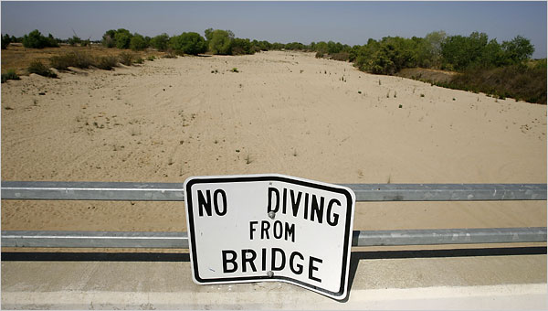
www.sawpa.org
Notes:
We must resist a desire to jump to a solution or to projects, and to invest time and energy to understand the whole system or watershed. How the issues fit together, how there could be unintended consequences. We guarded against quick fixes, emotional Nostrums, and superficial answers to our complex problems.
We have the opportunity to create a new
This all adds up to a New Water Ethic, we will value water differently. This is not about sacrifice or giving up quality of life or life style; it is about rediscovering that water is valuable and precious.
If we do nothing the current and future costs are enormous for rich and poor, republicans, and democrats, for profits and non profits, private and public sector.
The work ahead belongs to all of us. We invite you to embrace a 21st Century Water Ethic.

